Slide 1
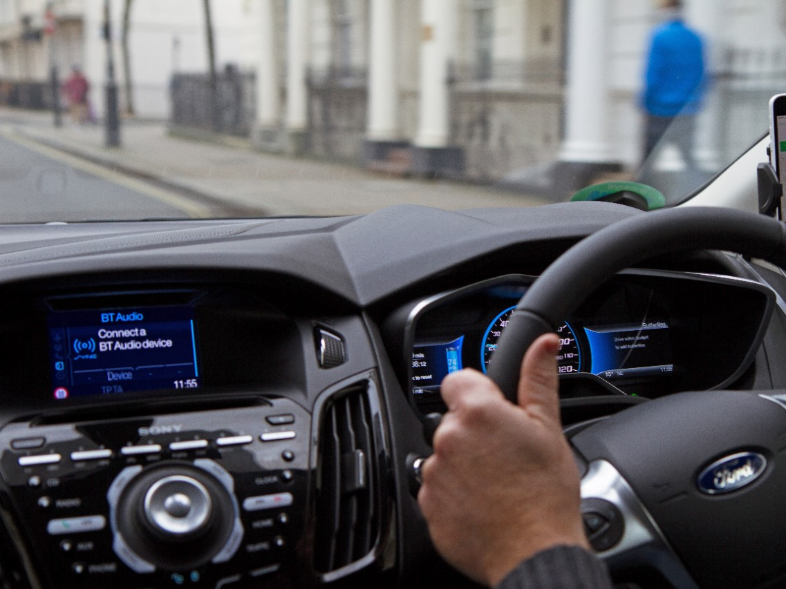
CSCI 6900: MMD Final Project:
Stay Alert! The Ford Challenge
By
Madhura Gadgil
Moumita Das
Sanath Bhat

Slide 2
Problem Definition
Driving while not alert can be deadly!
The objective of this challenge is to design a classifier that can detect whether the driver is alert or not using data that was acquired while driving.
Data includes 3 types of features:
Vehicular
Environment
Physiological

Slide 3
Data
Training data:
Results of 500 'trials' of driving from about 100 drivers of both genders, different age and ethnic backgrounds
Each trial has about 2 minutes of sequential data recorded every 100ms => approx 2*60*10 = 1200 readings
Total data rows = 604330
Total data columns = 33

Slide 4
Data
Structure of data
Trial ID | Observation No | Is Alert? (0/1) | P1...P8 (Physiological data) | E1...E11 (Environmental Data) | V1...V11 (Vehicular Data)

Slide 5
Data
Testing data:
About 100 trials of about 2 minutes of sequential data recorded every 100ms => approx 2*60*10 = 1200 readings per trial
Total data rows = 120840
Total data columns = 33
Testing data has a '?' in the IsAlert column

Slide 6
Measuring model effectiveness
We consider 3 measurement statistics
1. AUC ROC: Area Under Curve of Receiver Operating Characteristics
Maximize True +ve rate / False +ve rate
Chosen by the posters of the competition as it specifically suits the domain
2. Accuracy
Maximize True +ve and True -ve rate
F1 Score
Harmonic mean of Precision and Recall

Slide 7
Previous Work
First place :

